Slide 1
EV ARC™ 2020
World’s Fastest EV Charging Deployment

Slide 2
Get the EV Charger of Your Choice, Deployed in Minutes not Months
No Permitting
No Construction
No Electrical Work
No Utility Bill

Slide 3
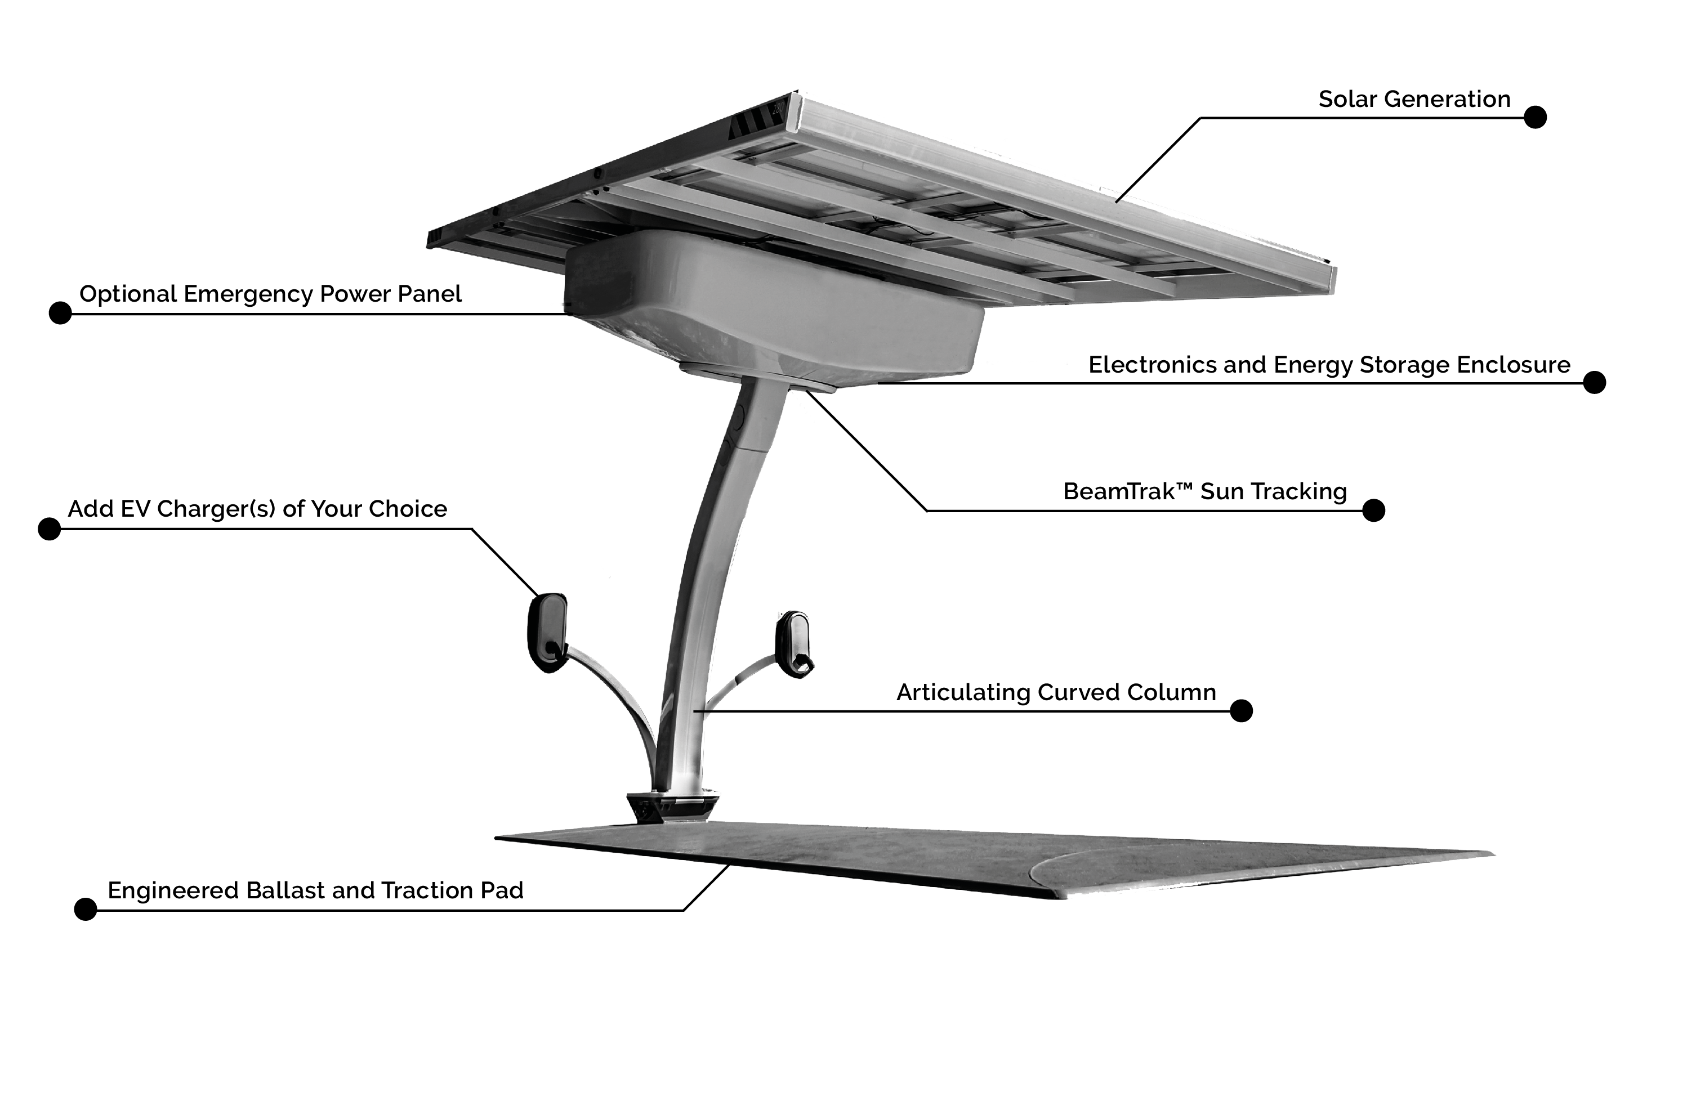
EV ARC™ 2020

Slide 4
Installing Grid-Tied EV Charging Includes
Engineering
Construction
Trenching
Foundation
Permitting
Electrical circuit work
Project management
Transformer / switchgear upgrades
Utility metering / monthly bills
Utility interconnect agreements
Demand charges
Carbon Footprint

Slide 5
EV ARC Redeployed for COVID Test Site
https://vimeo.com/466704215
https://vimeo.com/466704215

Slide 6
EV ARC™ 2020 Solves Your Problems
No Permitting, No Construction, No Utility Bill
Fastest and easiest to deploy solution on the market
The EV charger brand and service of your choice
Deploys in minutes, zero-contact delivery
Avoided costs = Lowest total cost of ownership (TCO)
Transportable
Off-grid EV charging and emergency power
Highly visible sustainability initiative
Drive on Sunshine

Slide 7
EV ARC™ 2020 Fits in a Standard Parking Spot
Maintain full parking capacity
Cars park on the base pad
ADA compliant
Reach as many as 12 parking spaces
Charge up to 6 vehicles at the same time

Slide 8
EV ARC™ 2020 Transportability = Flexibility
Drop and charge. Can be moved any time.
Permanent yet transportable
Scalable
Can be moved short distances with a forklift
Can be moved longer distances with the ARC Mobility™ Trailer, truck or in a 20 ft. container
Ideal for leased or owned properties

Slide 9
ARC Mobility™ Trailer Deploys in Minutes
https://vimeo.com/466705736

Slide 10
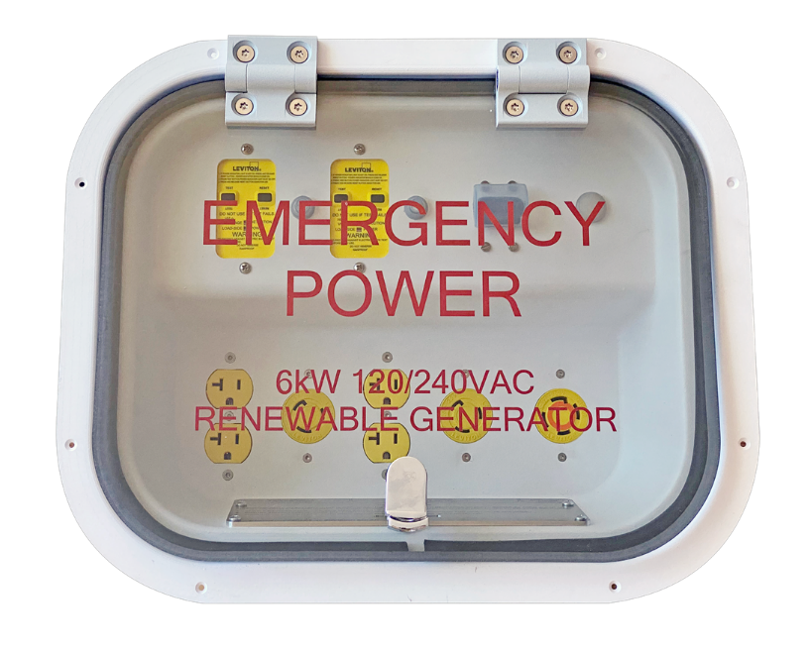
EV ARC™ 2020 Off-Grid Emergency Power
Energy when and where you need…
Charge during blackouts, utility outages, weather events
Relocate to high risk locations, hospitals, shelters…
Wind-rated up to 120mph
Flood-proof up to 9.5 feet
Working asset during prosperity and emergencies
Integrated emergency power panel

Slide 11
Emergency Preparedness for First Responders
EV charger becomes a lifesaver
Generators sit idle in storage most of the time
Renewable power: No refueling
Clean power: No toxic emissions
Quiet power: No disruption for medical staff or patients
Safe power: No volatile fuel to transport or store
Included in FEMA's Authorized Equipment List (AEL)*
* Beam Global EV ARC™ solar-powered charging stations are included in the FEMA Authorized Equipment List, under designation 10BC-00-SOLR Chargers.

Slide 12
Real Time Data & Reporting
Standard Reporting
Wireless connectivity transmits real time data for reporting on:
State of batteries
State of PV charging
Rate and amount of energy delivery
Time and duration of EV charging (approx.)
Carbon offset
Optional Reporting
Wireless connectivity transmits real time data for reporting on:
Time and duration of EV charging (exact)
Time of charge
Kilowatt hours (kWh) delivered
Optional billing / access control
Drive identification

Slide 13
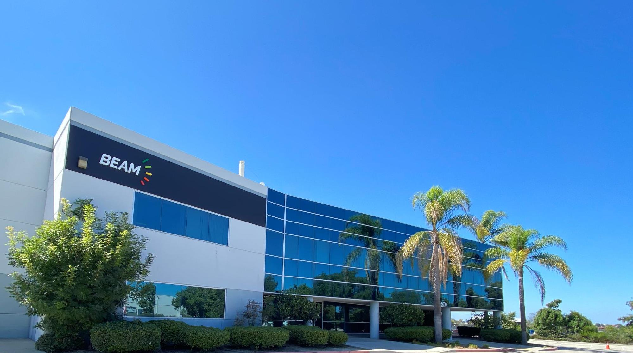
Founded in 2006
Publicly Traded Company (Nasdaq: BEEM)
Products manufactured at our facilities in San Diego, California
We proudly employ combat veterans, disabled workers and other highly motivated individuals

Slide 14
Our Customers Have a Lot to Beam About

Slide 15
Drive on Sunshine
THE BEAM TEAM
+1 (858) 799-4583
BeamTeam@BeamForAll.com
BeamForAll.com

Slide 16
Drive on Sunshine
Thank You
Andy Ike
Clean Mobility Sales Manager
M (858)-799-4583
O (858)-799-4583
Andy.Ike@BeamForAll.com
BeamForAll.com

