Slide 1
Regulatory Landscape
for Electric Vehicle Charging in New York-Overview & Personal Reflections
Commissioner Diane X. Burman, NY PSC
Zeryai Hagos, Deputy Director, Markets and Innovation, NY DPS
--Wednesday, October 7, 2020 --
Virtual EV Charging Infrastructure Conference

Slide 2
Personal Disclaimer

Slide 3
Regulatory History of EV Charging in NY
April 2018: Proceeding Regarding EVSE&I directed Staff to identify and address immediate and long-term actions to support ZEV growth, specifically directed Staff to host a technical conference and expeditiously issue a whitepaper – 18-E-0138
Nov. 2018: Residential EV Tariff Order EV-specific TOU rates filed with traditional residential customer charge
Feb 2019: DCFC Program Order established six-year per-plug incentive program
Jan 2020: EV Make-Ready White Paper proposal provides up 90% support to cover the costs of making a sites ready for public EV charging
EV Make-Ready Program Adopted by Commission July 16, 2020

Slide 4
NYS Clean Energy Goals Impacting Transportation
Zero Emissions Vehicles MOU
CLCPA GHG Targets
Note: CO2e calculations do not fully reflect methodology required by CLCPA
Million metric tons of CO2
850,000 EVs on NY roads by 2025 (~8%)
~50,000 EVs today (<1%)
40% GHG ↓ by 2030… 85% by 2050
35-40% programming to benefit DAC
1.8 - 2.2 million ZEVs needed to meet 2030 GHG↓ goal
Source: NYSERDA, DPS, EIA

Slide 5
EV Make-Ready Program Adopted by Commission July 16, 2020
$701 million budget; $206 million dedicated to disadvantaged communities
Budget sized to incentivize enough EV charging stations support 850,000 ZEVs by 2025
53,773 level 2 and 1,500 direct current fast chargers
Program is active now; Midpoint review begins Oct 2022; program ends Dec 31, 2025
Fleet Assessment Service created to aide fleet owners with site feasibility and rate analysis
$85 million dedicated to prize competitions in disadvantaged communities
Primary focus of the program is light duty vehicles

Slide 6
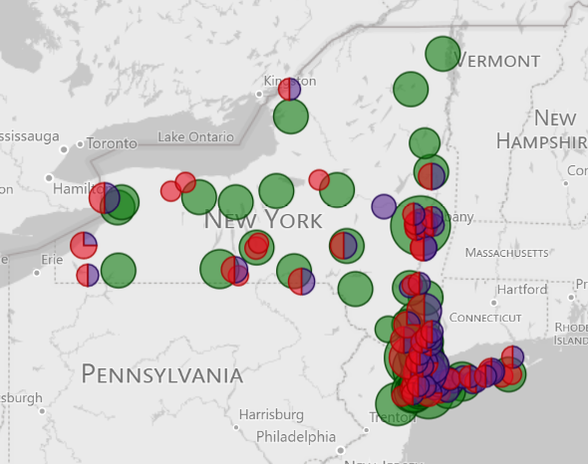
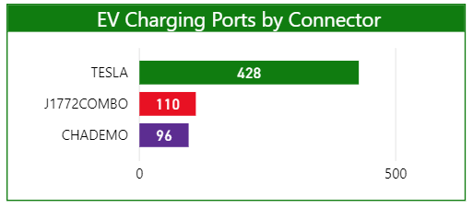
New York DCFC Charging Landscape
Tesla makes up the majority of publicly available DCFC stations in NY
Range anxiety is #1 concern cited by potential EV buyers in the US
Source: Atlas EV Hub, Size of Circle Based on # of Ports
Significant increase in stations needed to support EV growth targets
Notes:
https://www.atlasevhub.com/materials/ev-charging-deployment/

Slide 7
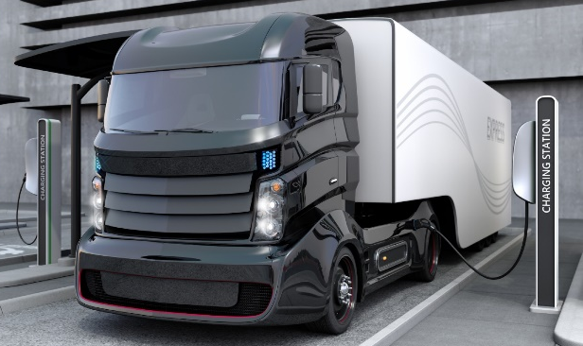
Next steps for New York
Implementation
Monitor
Expand/Other Focus Areas
Utility incentive programs
Prize competitions
Technical Standards & Customer Experience Working Groups
Application process
Station utilization
Utility performance
Medium- and- heavy- duty programs
Managed charging
Notes:
You can mention resiliency, safety and other issues that require coordination with other state agencies can be taken up by the working groups referenced in the 1st column, when you get to “Expand/Other Focus Areas”.

Slide 8
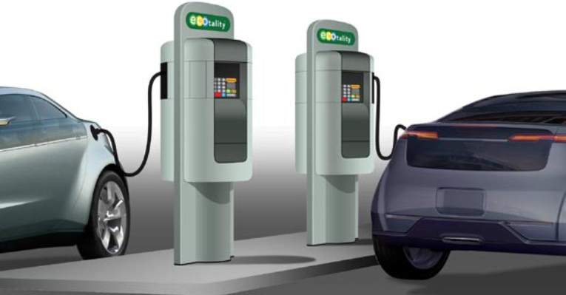
Key Regulatory Issues for Consideration
Future Gaps and Data Analysis and Research
Impacts on the Grid
Consumer Awareness and Interest
Interoperability Standards
Rate Design
Residential
Demand Charges
Ownership of EV Charging Infrastructure
Accessibility
Capital Planning Process
LMI/EJ Communities
Misc.

Slide 9
Questions?

